Slide 1
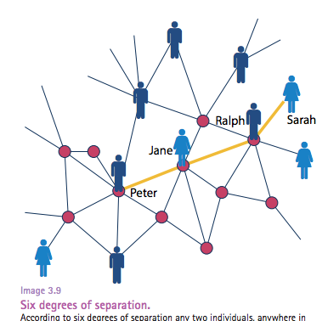
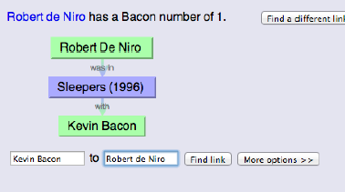
Complex Networks: Small World Property
Ana Paula Couto
Computer Science Department
Universidade Federal de Minas Gerais
Network Science Book – Albert Barabasi

Slide 2
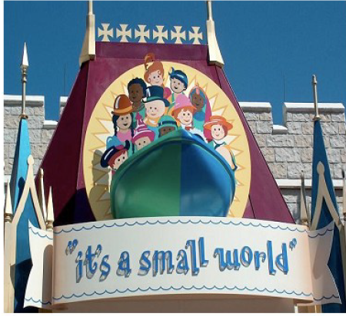

Slide 3
Small world phenomenon
Also known as six degrees of separation
If you choose any two individuals anywhere on earth, you will find a mean path of six acquaintances between them

Slide 4
Small world phenomenon
In other words …
The distance between two randomly chosen nodes in a network is surprisingly short

Slide 5
Small world phenomenon
What does short (or small) mean, i.e. short compared to what?
How do we explain the existence of these short distances?

Slide 6
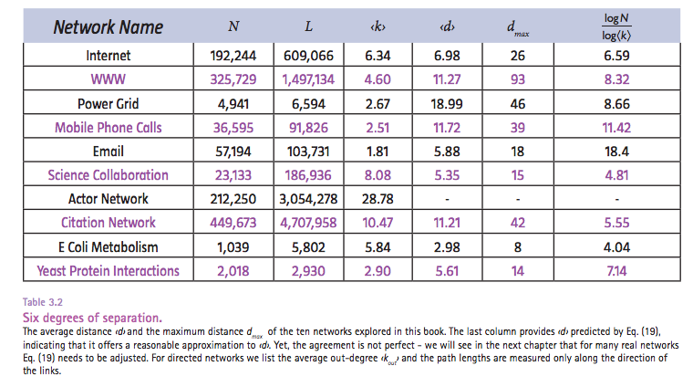
Network Science Book – Albert Barabasi

Slide 7
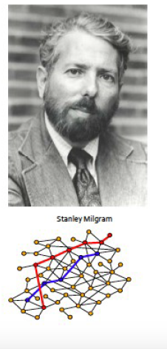
Small world experiment
Stanley Milgram: 1967
Targets
stock broker in Boston (MA)
student in Sharon (MA)
Randomly selected residents
Wichita, Kansas, Omaha (Nebraska)
Letter with:
Summary of the experiment
Photography, name, address and
Information about the target person

Slide 8
Small world experiment
Residents were asked to forward
the letter to a friend, relative or
acquaintance, who is more like
to know the target person
“I (Milgran) asked a person of
intelligence how many steps the
thought it would take, and he said
that it would require 100 intermediate
persons, or more, to move from Nebraska to
Sharon”

Slide 9
Small world experiment
After few days, the first letter
arrived: only 2 hops!
42 of the 160 letters made it back,
some requiring close to a dozen
intermediates
Completed chains: number of
intermediates was 5.5!

Slide 10
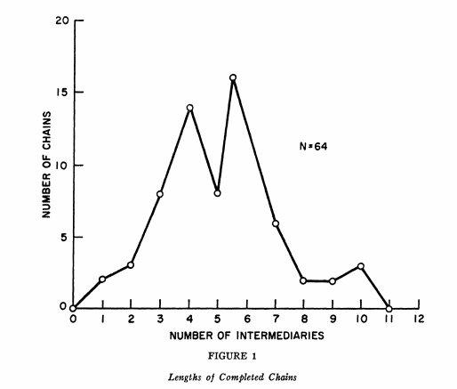
Small world experiment

Slide 11
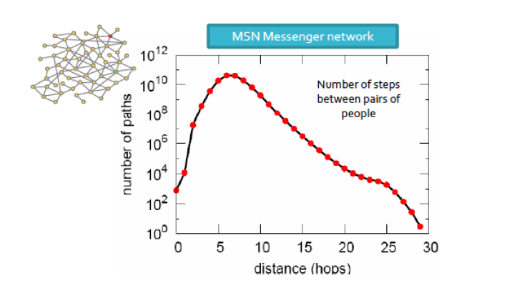
Small world (MSN network)
90
90% of people can be reached in 8 hops
Mean Shortest Path: 6.6 hops

Slide 12

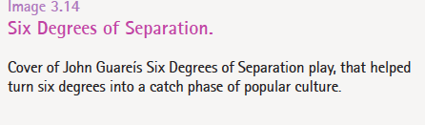
Six degrees of separation
Network Science Book – Albert Barabasi

Slide 13
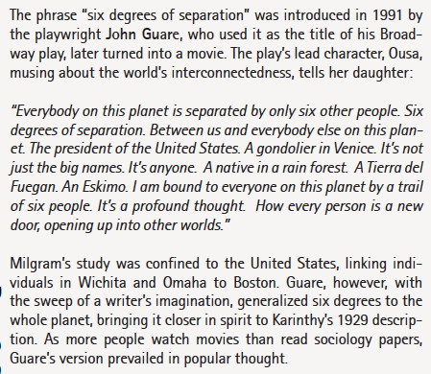
Six degrees of separation
Network Science Book – Albert Barabasi

Slide 14
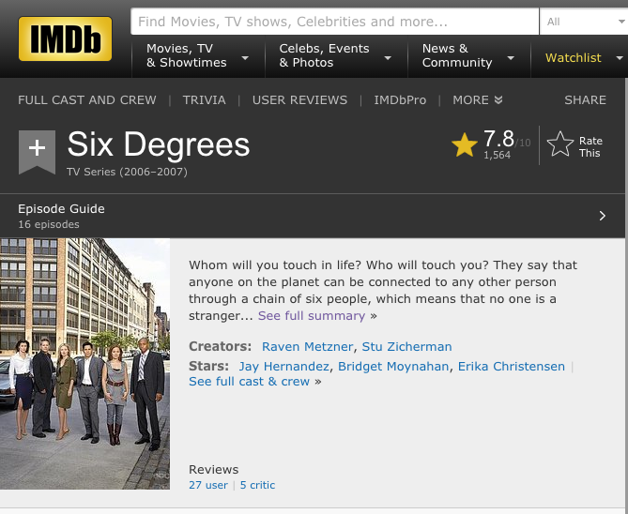
Six degrees of separation

Slide 15
Six degrees of separation: Kevin Bacon
Game created on 1994
Network of Hollywood stars
Two actors are linked together if they were at the same movie
Bacon Number: total number of hops until reach Kevin Bacon

Slide 16
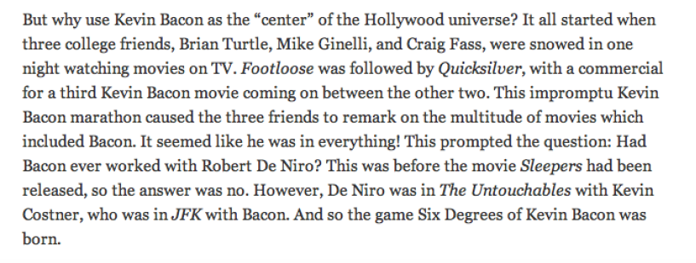
Six degrees of separation: Kevin Bacon
Notes:
Falar um pouco sobre a talk do kevin bacon

Slide 17
Six degrees of separation: Kevin Bacon
Most paths: 6 or less hops
329 of the 1605485: 7 or more hops
Only 12% of actors are not connected to Kevin Bacon

Slide 18
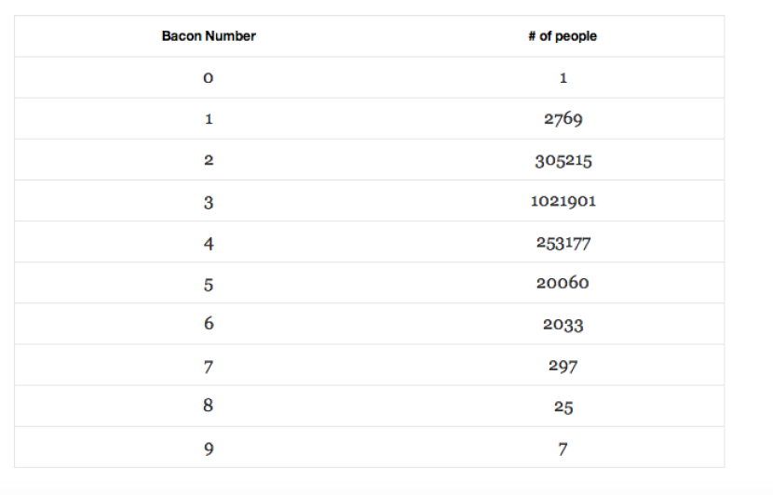
Six degrees of separation: Kevin Bacon

Slide 19
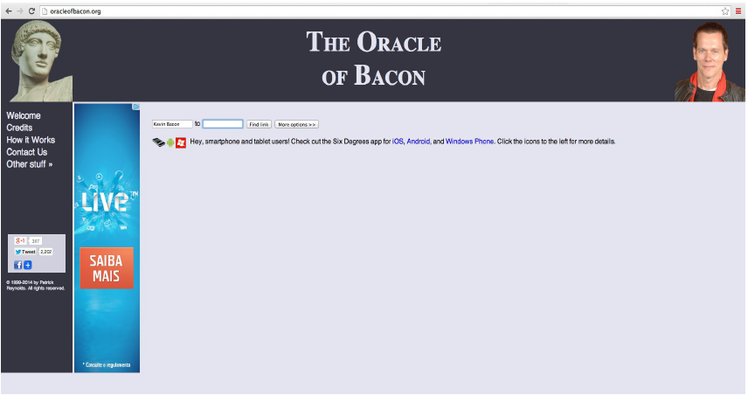
Six degrees of separation: Kevin Bacon

Slide 20
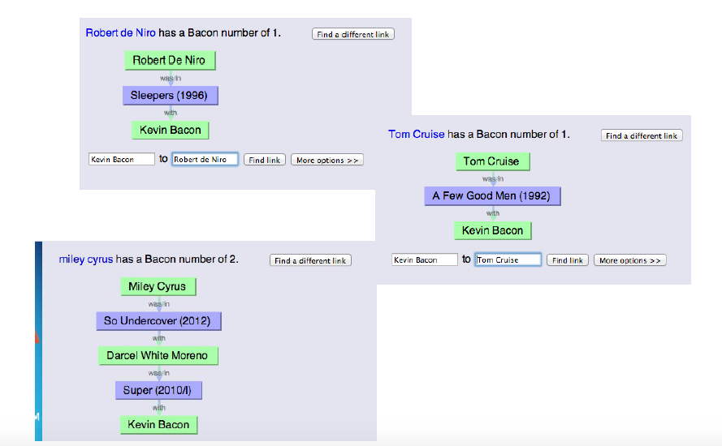
Six degrees of separation: Kevin Bacon

Slide 21
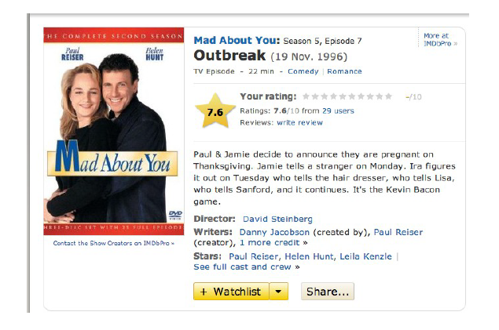
Six degrees of separation: Kevin Bacon

Slide 22
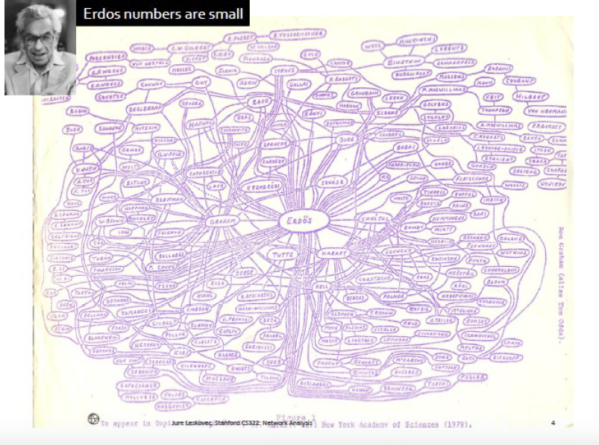
Six degrees of separation: Erdos Number

Slide 23
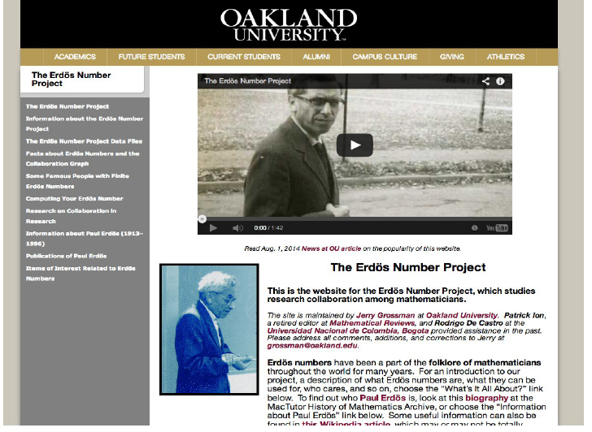
Six degrees of separation: Erdos Number

Slide 24
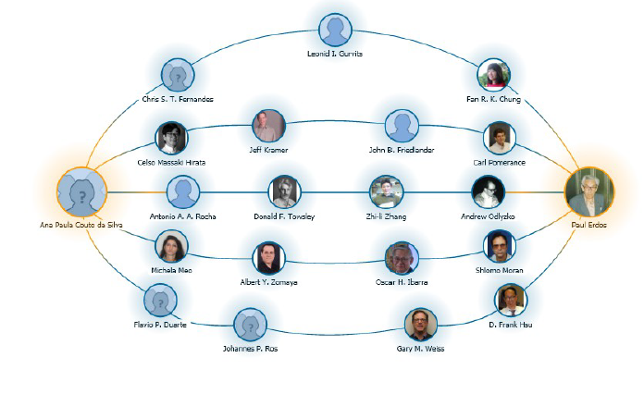
Six degrees of separation: Erdos Number

Slide 25
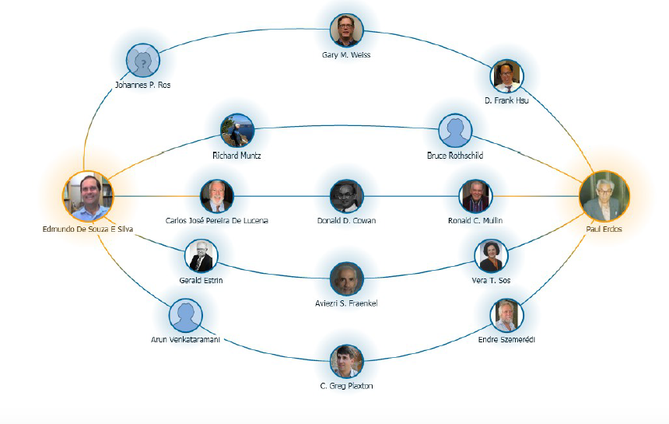
Six degrees of separation: Erdos Number

Slide 26
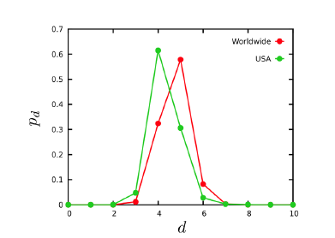
Six degrees ? Facebook finds only four! (2011)
Network Science Book – Albert Barabasi
Notes:
May 2011, 721 million active users and 68 billion symmetric friendship links, the average distance betweenthe users was 4.74

Slide 27
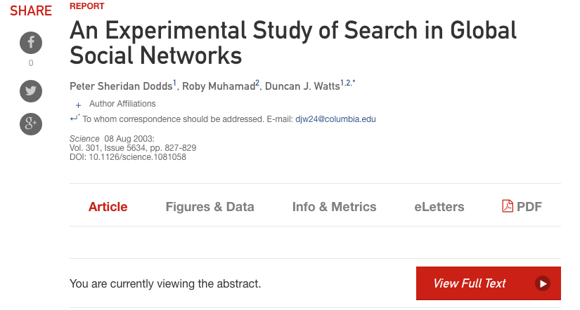
Revisiting Milgram experiment

Slide 28
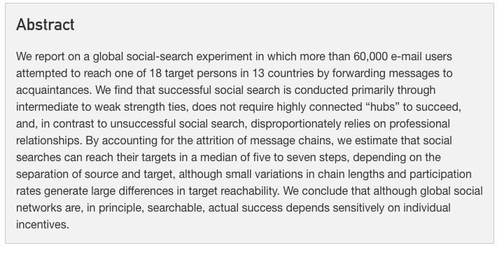
Revisiting Milgram experiment
P. Dodds, R. Muhamad, D. Watts, An experimental study of search in global social networks, 2003
Notes:
The search strategy is something that is interesting to think about. How people try to reach the destination? Taking into account geographical information? Professional information? Age information?

Slide 29
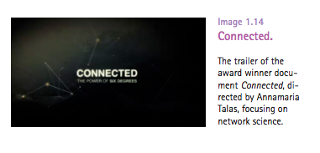
Connected : The Power of Six Degrees (2008)
http://www.imdb.com/video/wab/vi2571502361/
Network Science Book – Albert Barabasi

Slide 30
Some interesting references
The six degrees: Kevin Bacon at TEDx Midwest
https://www.youtube.com/watch?v=n9u-TITxwoM&nohtml5=False
J . Travers, S. Milgram, An Experimental Study of the Small World Problem, Sociometry, 1969
D. Watts and S. Strogatz, Collective dynamics of “small-world” networks, Nature, 1998
J.Kleinberg, Navigation in Small World, Nature, 2000
P. Dodds, R. Muhamad, D. Watts, An experimental study of search in global social networks, 2003
J. Kleinberg, The small-world phenomenon: An algorithmic perspective, 2000

